Slide 1
A case for accelerator based VR content generation on edge towards energy-efficiency
Presented by: Sridhar Gunnam
Advisor: Prof. Robert LiKamWa

Slide 2
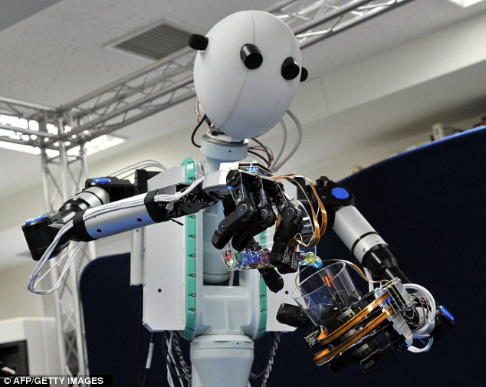
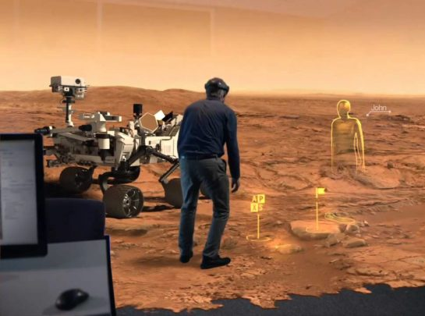
Proliferation of VR in different applications
Remote Robotic Vision
VR tour to Mars
Notes:
We can imagine looking into VR headset and performing tasks remotely.
Robot is mixing the chemicals
Person is inspecting mars remotely.

Slide 3
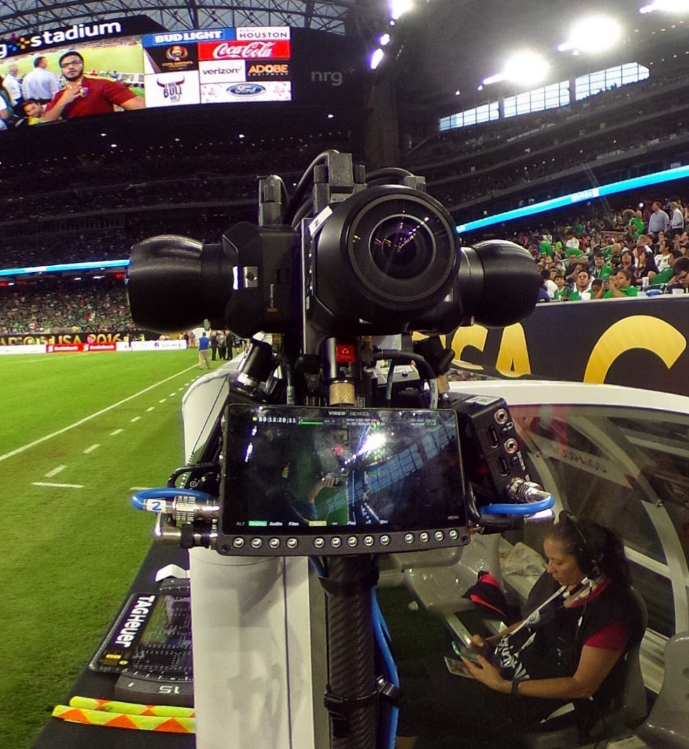
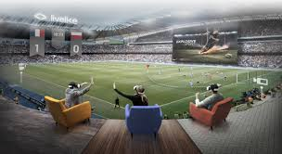
Proliferation of VR in different applications
Watching a soccer match in VR
Notes:
Enjoying a soccer match as if you were there in the stadium.
Enjoying such experience means immersion in the scene.

Slide 4
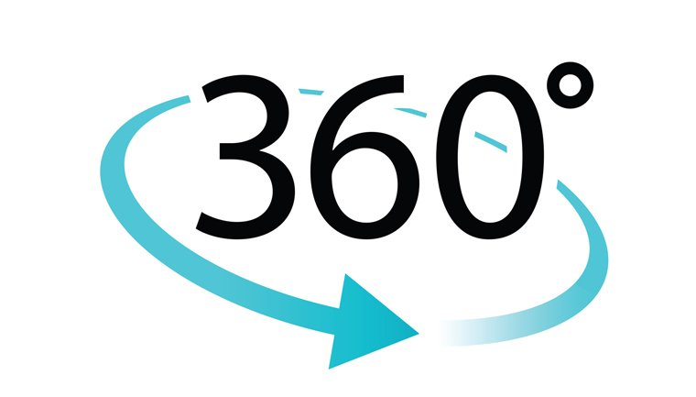
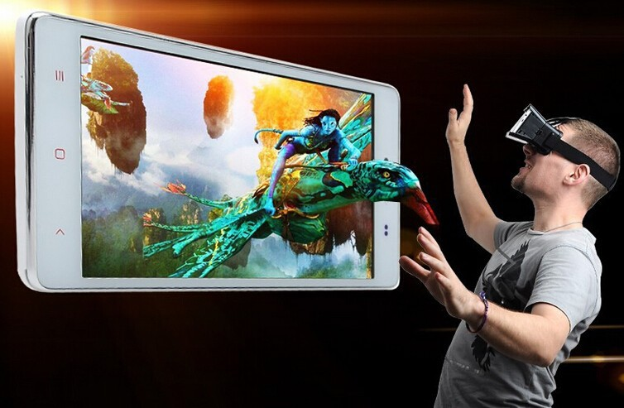
VR needs highly immersive experience
3D(depth)
Notes:
The ability to look around and to perceive how far or how near things are away from you?
Is 360 and 3D enough?

Slide 5
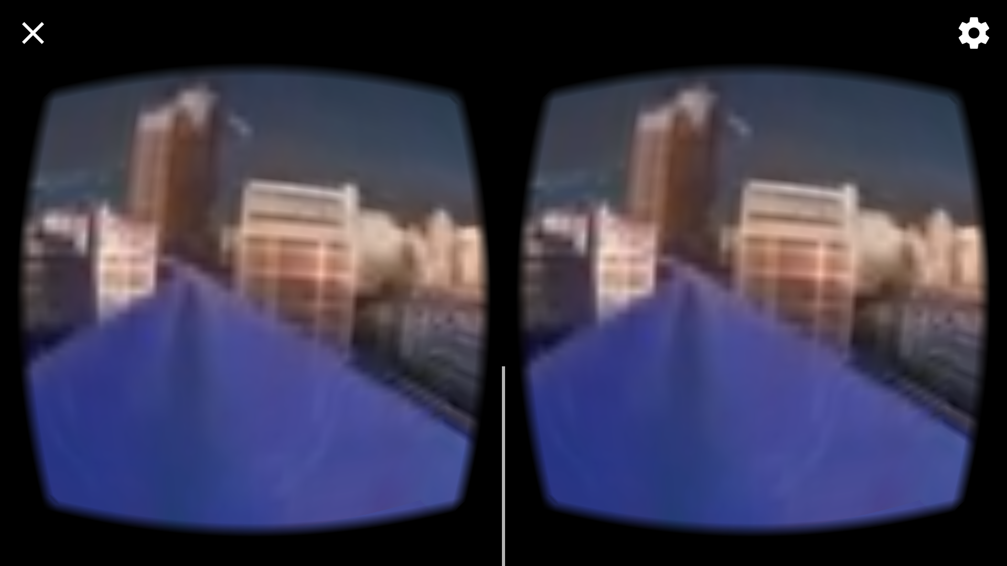
VR needs higher resolution
VR needs >16k Resolution.
4k for VR is like 144p for mobile
Pixelated view
Notes:
Each degree in VR needs 60 pixels. 4k ➔ 10 pixels/degree
How do we generate how resolution and immersive content for VR?

Slide 6
Content generation for VR is an emerging research problem
Untethered and long battery life
Low latency
High data rates and high computations
But low power and low latency??
Notes:
Because of high resolution we have higher data rates!
But we need low power for battery constrained capture device,
Low latency for realtime applications

Slide 7
What does low power and low latency mean?
Power of device is in the range of few Watts.
Capture and compute is in few hundreds of milliseconds.
Notes:
Can commertial solutons solve this problem?provide this?

Slide 8
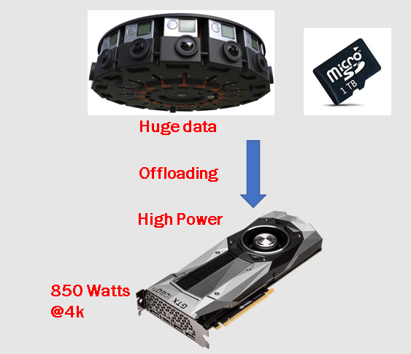
Commercial solutions consume high power
High compute power
1000’s of CPU’s
Or Several GPU’s
If 10% of US population uses VR at a given time
#GPU’s needed = 32.5 Million
Power burnt = 27625 Mega Watts
~1-2 Hours
Capture Time
Notes:
Capture and offload !
http://360rumors.com/2018/05/best-worlds-insta360-pro-hands-real-world-review-part-1-sample-photos-videos.html#guide

Slide 9
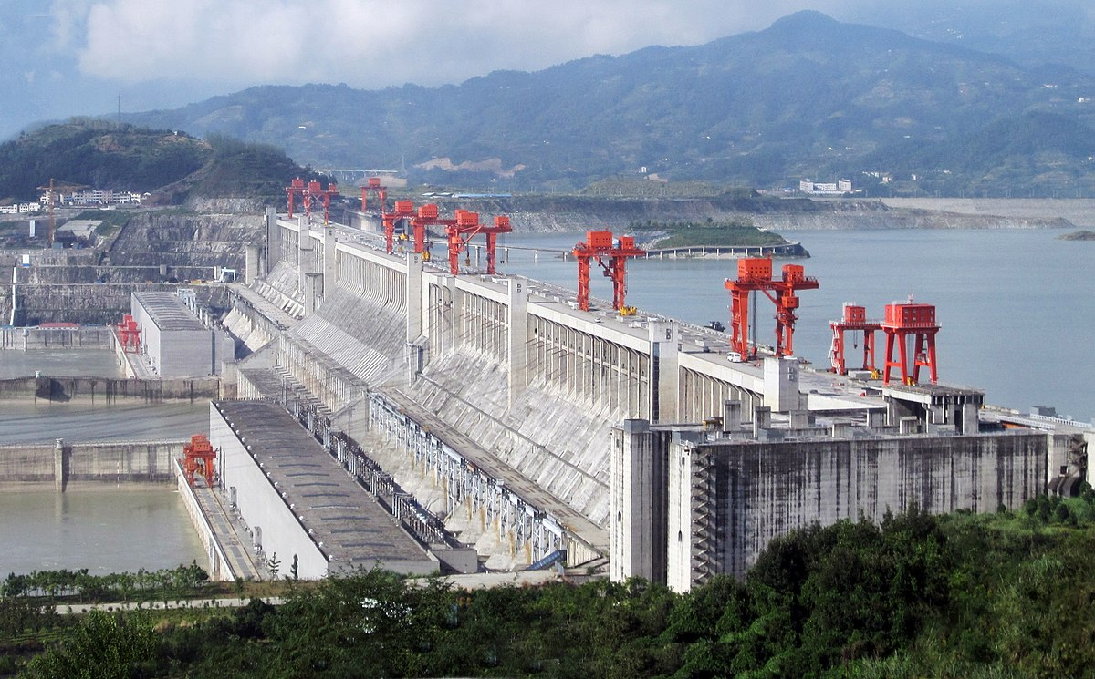
27625 Mega Watts: Greater than world’s largest power plant “ The Three Gorges”
Notes:
What are going to do?
Build another dam for AR and MR

Slide 10
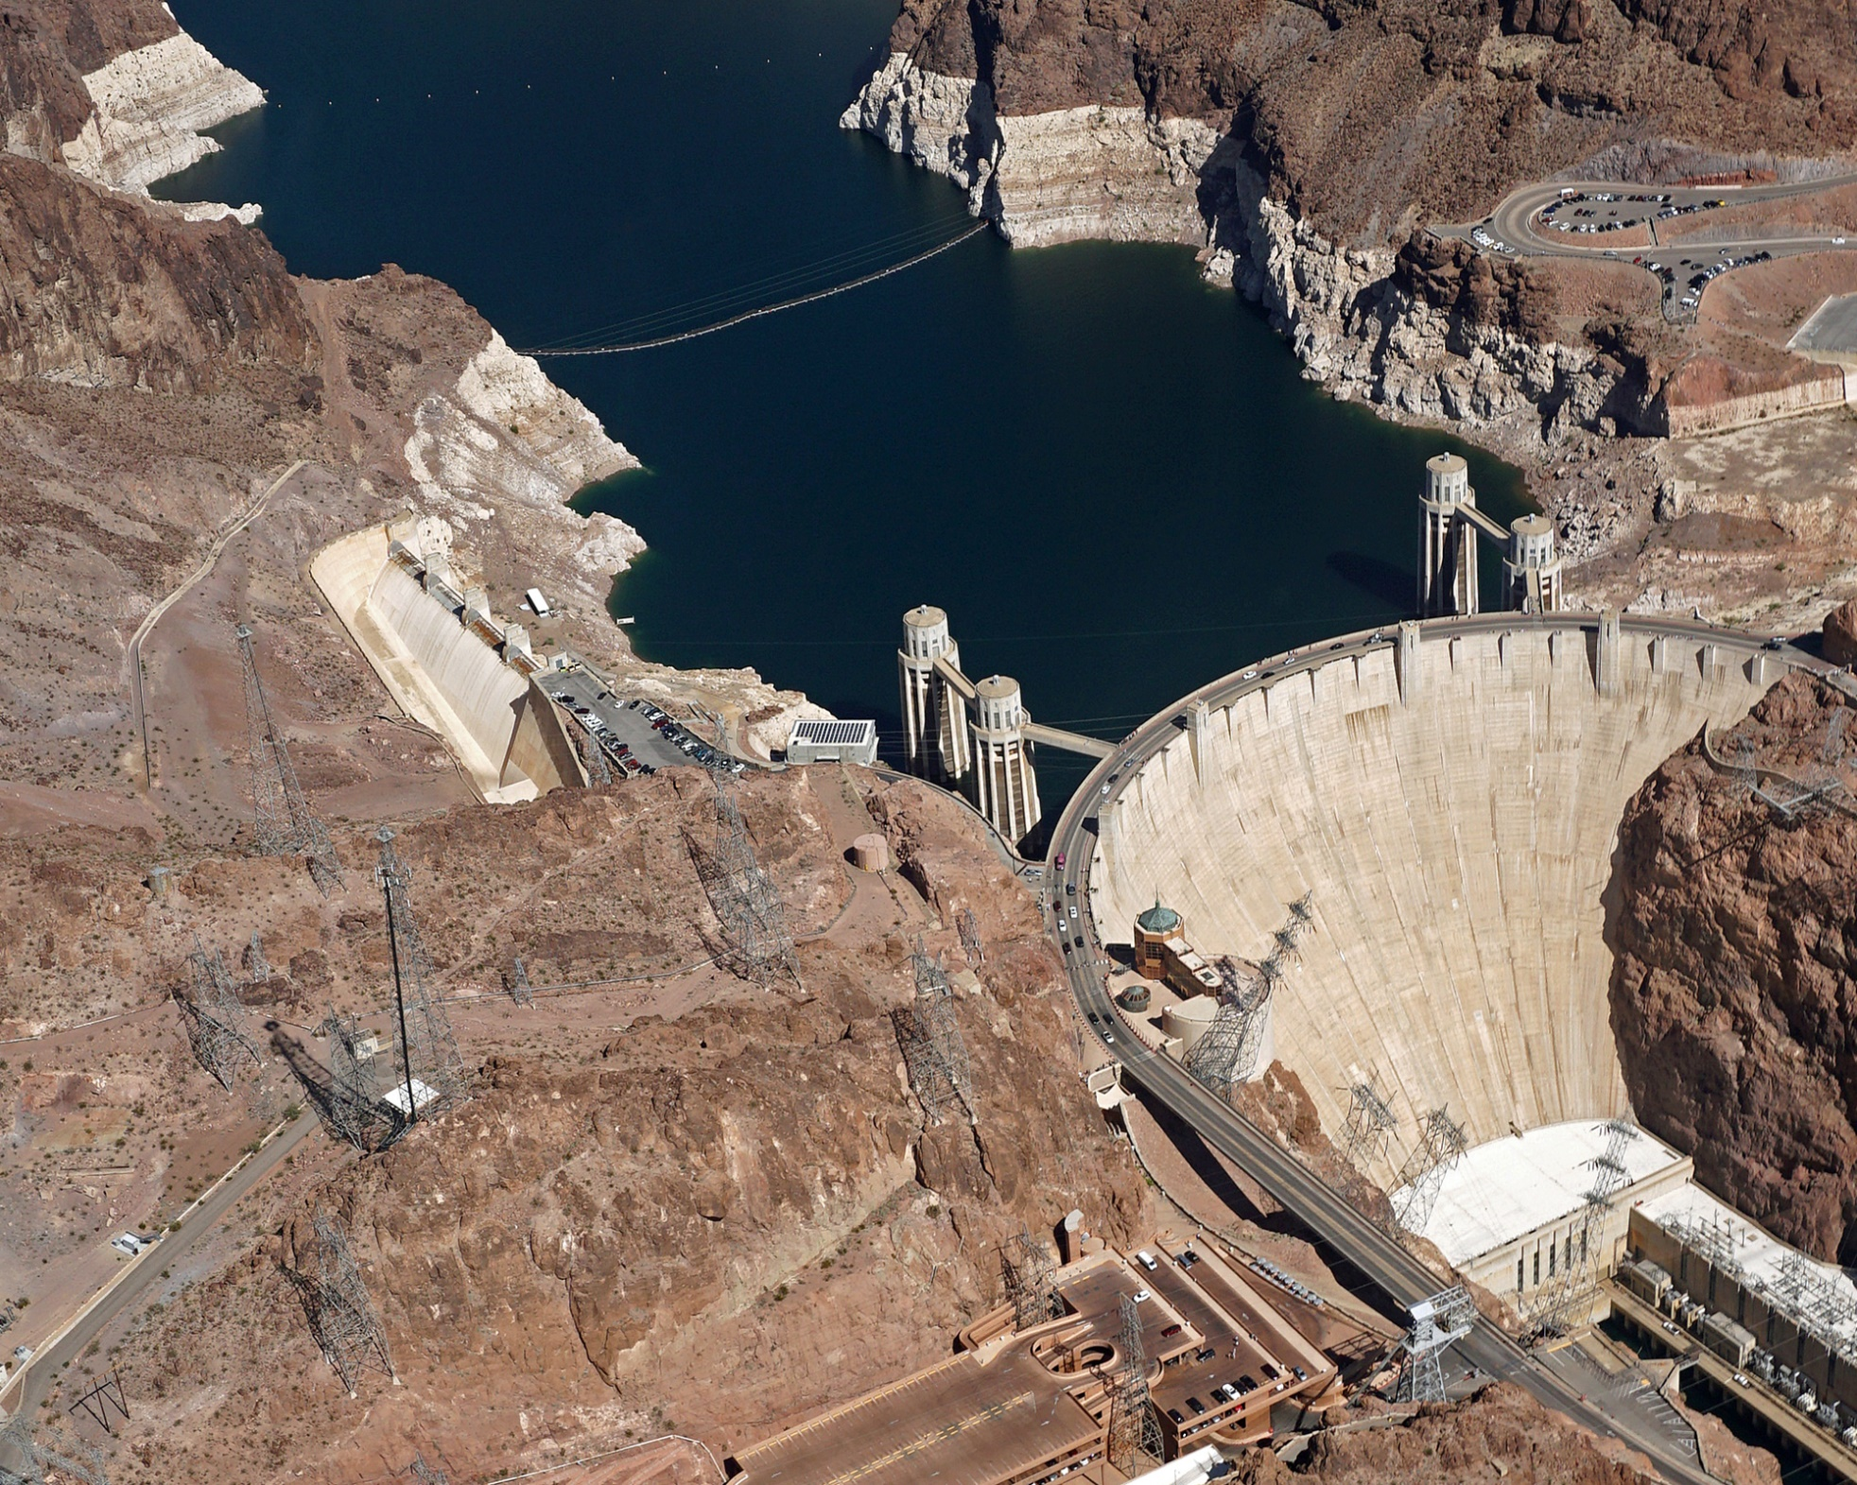
In terms of Hoover Dams!!
15 of those

Slide 11
Commercial solutions are have very high latency
High compute latency
1 hour of video takes 10 hours to stitch.
Network Latency
Sending the camera frames will be twice as expensive as sending the output panorama
Compression and decompression stages will dominate end-to-end latency.
Notes:
http://360rumors.com/2018/05/best-worlds-insta360-pro-hands-real-world-review-part-1-sample-photos-videos.html#guide

Slide 12
Can we come up with a viable solution?
That is
Low Power
Low Latency
Edge processing
Notes:
Edge means computing near the device used for capture. Reduce end-to-end latency
Which is the best way to analize the challenges and come up with viable solution
Why we need a hardware sys?

Slide 13
Remainder of the talk
Building a prototype
Characterization
Proposed optimizations
Notes:
Which is the best way to analize the challenges and come up with viable solution

Slide 14
Remainder of the talk
Building a prototype
Characterization
Proposed optimizations

Slide 15
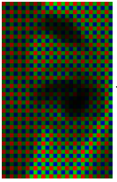

System Overview: Camera + Processor + Storage
Frontend
Backend
Capture
Processing
Camera
CSI
ISP
CPU
DDR
DRAM
Notes:
The system consists of different pieces of hardware.
Interface glues these systems.

Slide 16
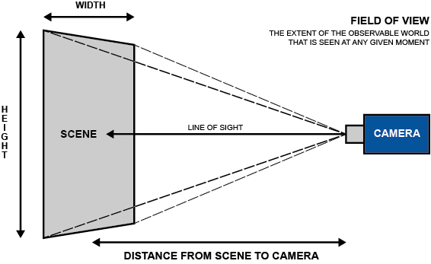
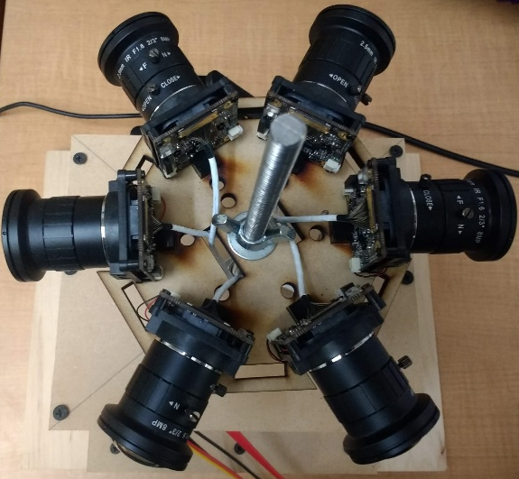
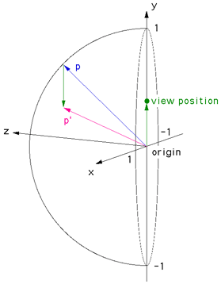
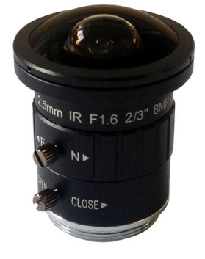
Camera system: How many cameras do we need?
Depends on field of view of camera lens
We use wide field of view lens
and 6 cameras
Minimum distance b/w scene objects and camera
Size of camera
Typ. Mobile Cameras
60º FOV
Fisheye Cameras
140º FOV to 210º FOV

Slide 17
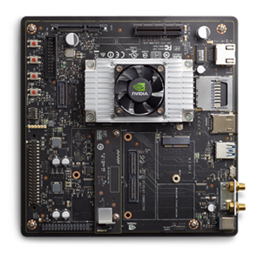
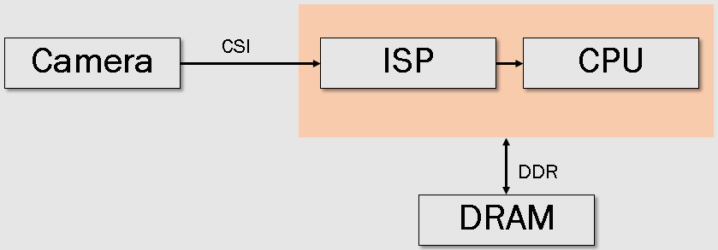
Processing Sub-System: CPU/GPU
In our system:
Quad core ARM A57
8 GB DRAM

Slide 18
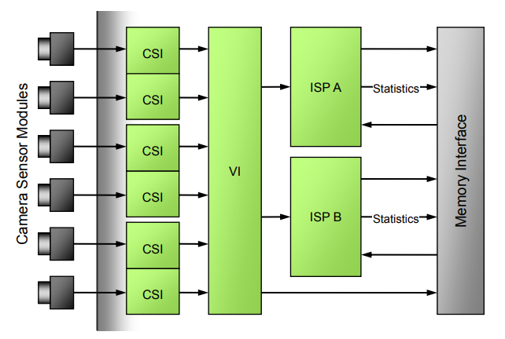
Interfaces in the System: CSI and DDR
Jetson Camera Interface

Slide 19
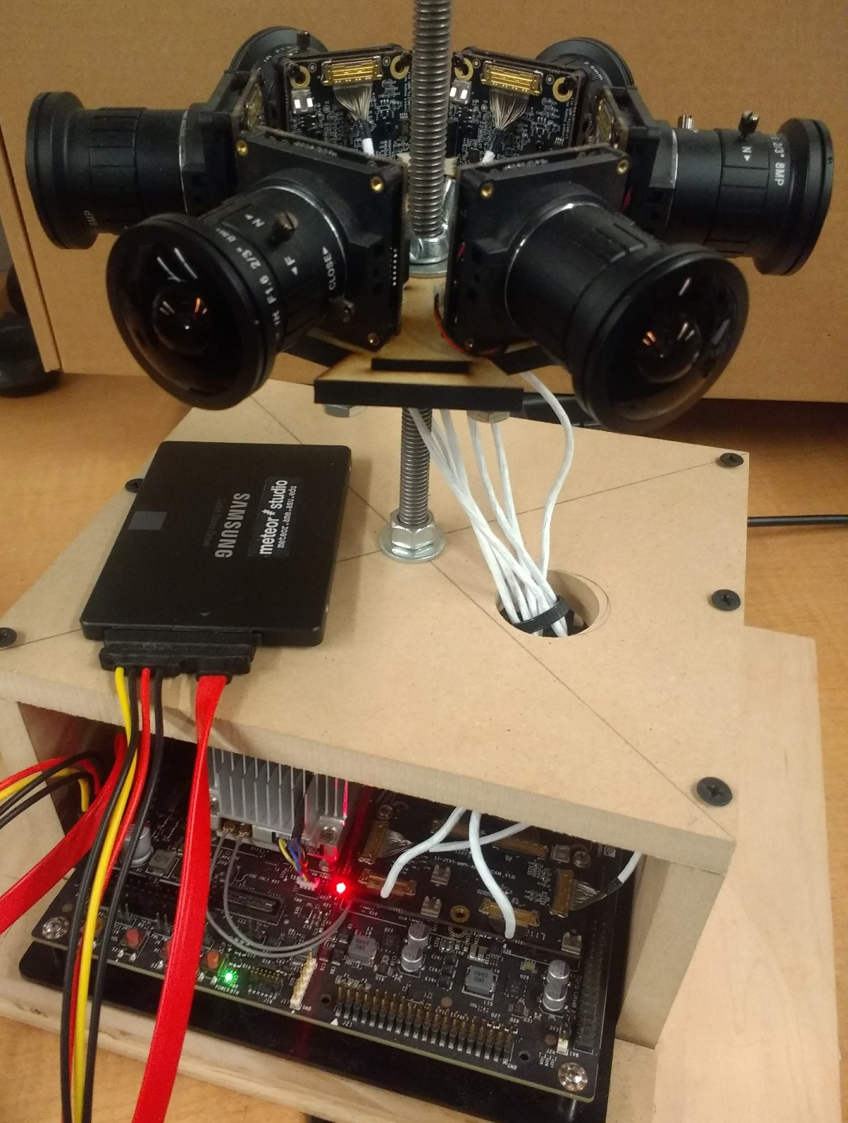
Prototype
Hardware:
Six Sony IMX 274 Cameras, wide fisheye lens
Nvidia Jetson TX2
ARM A57 quad core processor
Dual ISP with 1200 Million pixels/sec
Software:
Ubuntu 16.04 LTS
c++, openCV
Facebook surround 360
IMX274 cameras
CSI Interface
Disk
Jetson TX2
Notes:
Putting everything together. Show pride.

Slide 20
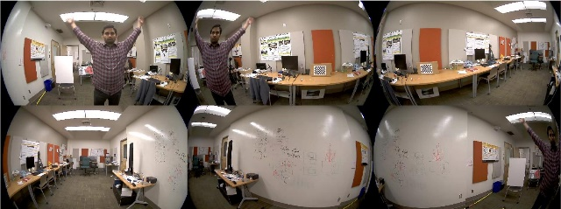
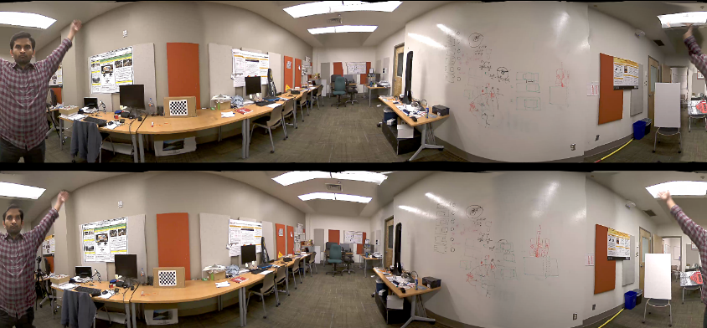
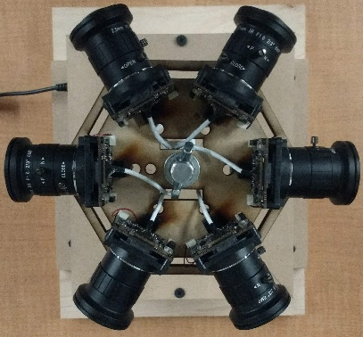
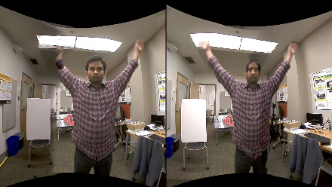
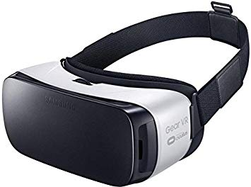
Inputs and outputs of the system
Left Eye
Right Eye
Notes:
capture entire 360 x 180, Mono – Portable, usable because of small size. ODS – Depth

Slide 21
Remainder of the talk
Building a prototype
Characterization
Proposed optimizations

Slide 22
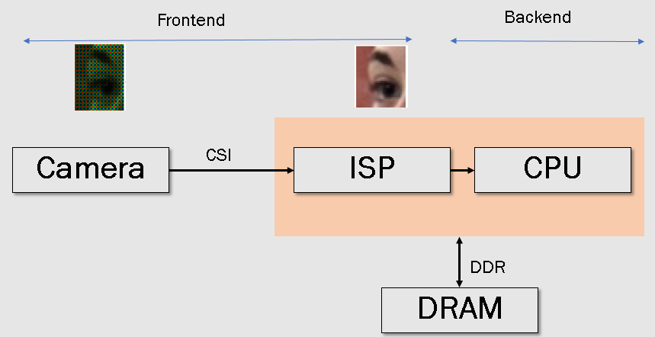
Key findings
High power consumption
Redundant capture
High data rates across interfaces
Redundant computations
Huge memory footprint
High processing latency
Sequential execution
Frontend
Backend
Notes:
What does redundant capture?

Slide 23
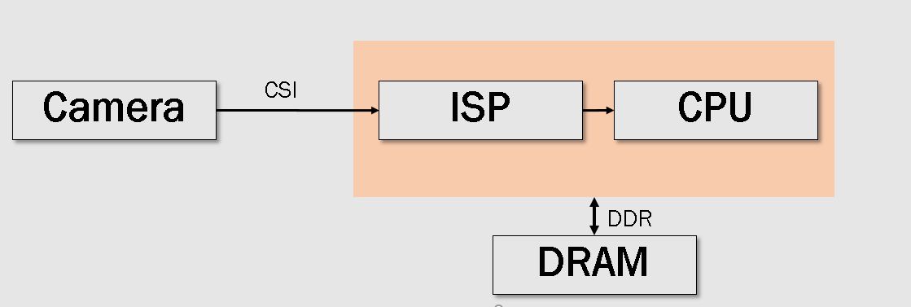
(1a) Redundant Capture
Cameras process frames even when the scene is not changing.
~500 mW per camera
Notes:
Cameras are dumb.
Natuarally there is lot of redundancy from one image to another
limit scalability of capturing to higher resolution and framerate and multiple of these cameras.

Slide 24
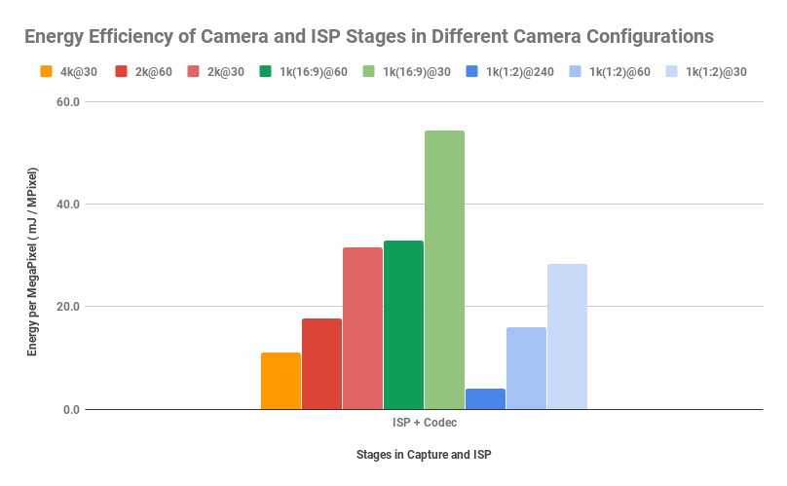
(1b) Underutilized Capture Pipeline can cost energy efficiency per pixel
Total Energy = Static + Dynamic
Underutilized Resources can cost static energy.

Slide 25
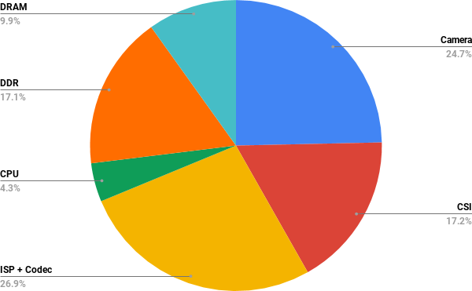
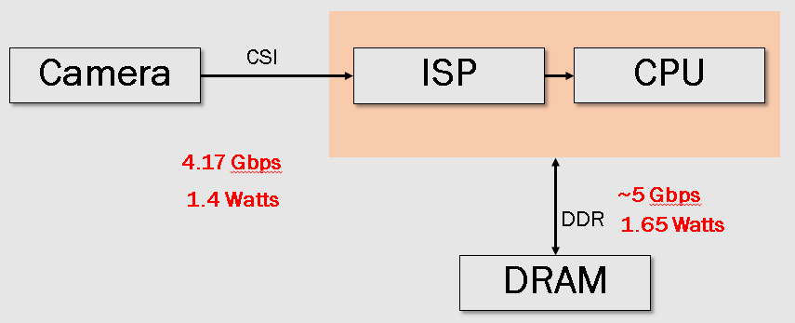
(2) High interface data rates are expensive
34% of total power
Notes:
The interfaces consume major chunk of power during capture.
DRAM is from micron and DRAM power simulator. Camera pulled from data sheet.

Slide 26
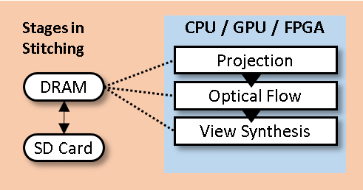
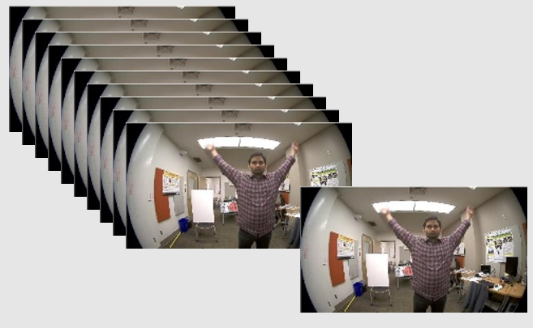
(3) Redundant computations
The computation is done on all the pixels of all the frames.
No reuse of previous results.
~100’s of million operations per output frame
Notes:
The frames to frame differences are small, implies that Same like cameras, traditional algorithms are not adaptive to compute only on the changes over the image.

Slide 27
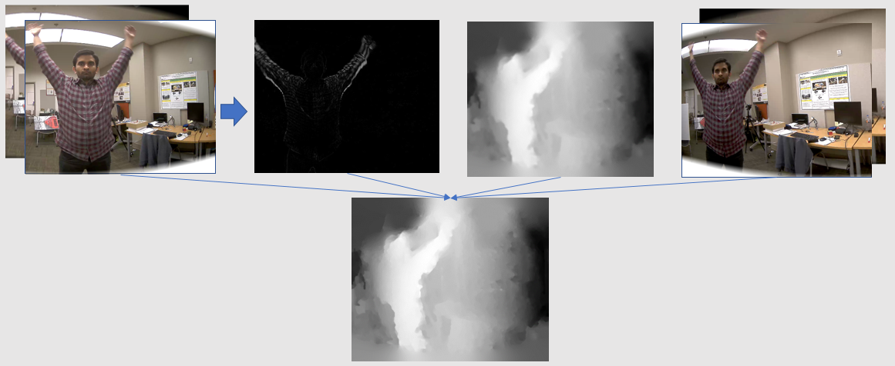
(4) Under-optimized data abstractions across subsystems increases memory footprint
388MB of data used for optical flow step.
Data format is single precision.
Notes:
Work on the figure.

Slide 28
Key findings
High power consumption
Redundant capture
High data rates across interfaces
4K @ 60 fps
Underutilized capture pipeline
Redundant computations
Huge memory footprint (240 MB)
High processing latency
Sequential execution
Frontend
Backend

Slide 29
(1) Sequential execution of computation across frames
CPU implementation will take 24 sec to generate each output frame
Stages | Sequential Execution Time
Projection | 2.89
Optical Flow | 16.21
View Synthesis | 4.5

Slide 30
Remainder of the talk
Building a prototype
Characterization
Proposed optimizations

Slide 31
Proposed optimizations
Low power
Reducing power of sensor
Spatial-temporal data reuse to minimize redundant computations
Low latency
Pipelined execution
Parallelize execution
Frontend
Backend

Slide 32
(1a) Reducing redundant ADC conversions
..
..
t=3
t=2
t=1
t=0
Temporal frames are similar!!
Cut down on Analog to Digital conversions
Notes:
How can we make the cameras smart?
: ADC inside camera burns 60% of the power
Power per pixel is 10 nWatts
ADC Conversion few nanoWatts

Slide 33
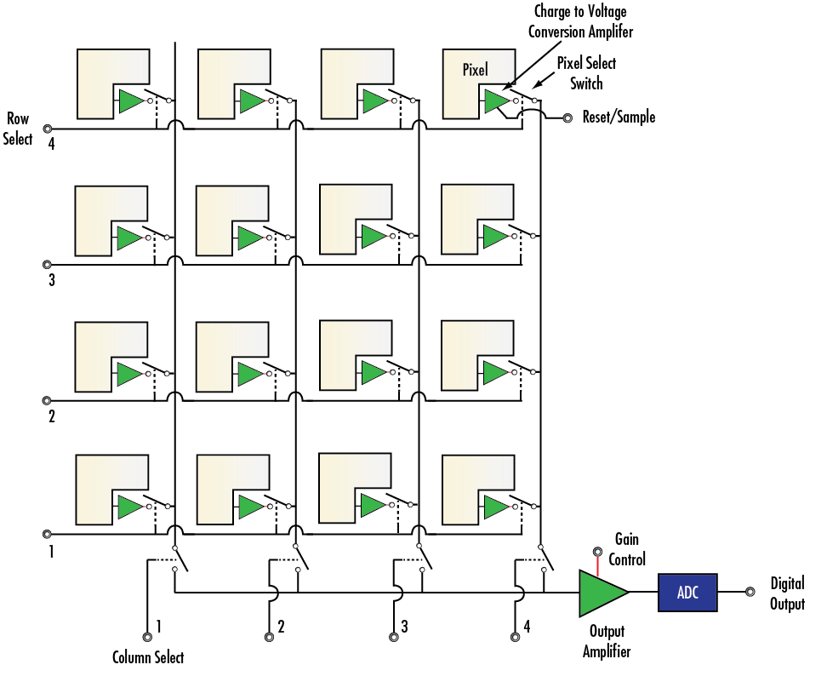

(1a) Reducing redundant ADC Conversions
We usually see bit changes only in the lower order bits.
Corresponding bits in previous frame bits can be used to guess higher order bits.
101101
101110
101111
…

Slide 34
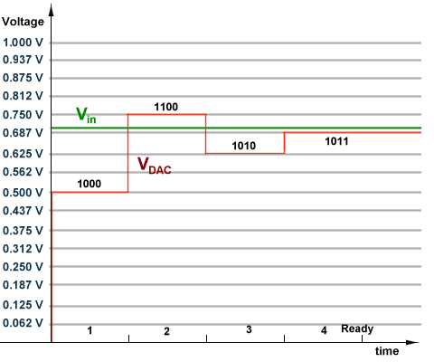
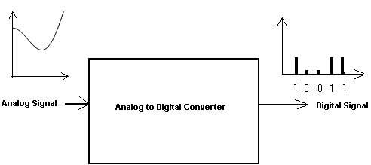
(1a) Reducing redundant ADC Conversions
ADC
Notes:
Binary search and find result in several iterations.
Reduce upto 80% of the total power.
Caution.

Slide 35
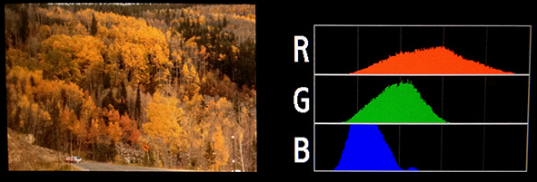
(1b) Near-sensor compression reduces CSI interface power
Region based histogram in ISP can be used for encoding sensor data
Camera
CSI
ISP
CPU
4.17 Gbps 1.4 Watts
to
~1.25 Gbps 0.4 Watt
DDR
DRAM
Notes:
Motion vectors from compression can be used to optimize optical flow

Slide 36
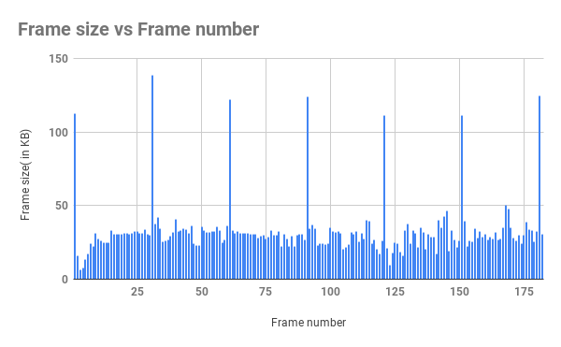
(1b) Near-sensor compression increases the scalability to higher resolution and framerate
Compression can reduces 70% of communication traffic from sensor to Processing unit

Slide 37
(2) (a) Improving data abstractions across subsystems reduces data requirement.
Uses previous frame for motion detection
Time=t, t-1
Time=t-1
Time=t, t-1
Problem:
Optical Flow stage loads current and previous frames
Notes:
Think Globally, Act Locally.

Slide 38
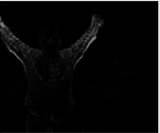
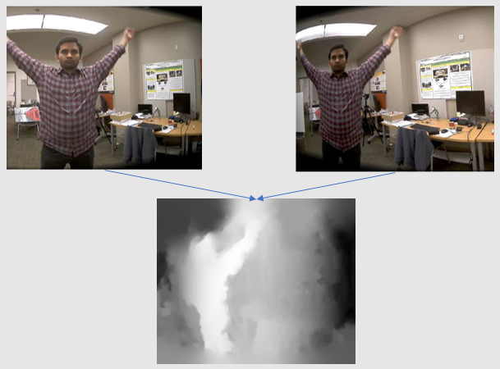
(2) (b) Under optimized data flow leads to increased memory footprint
Think Globally, Act Locally.
Time=t
Time=t
Reusing motion vectors from ISP stage, and reusing optical flow buffer reduces data size from 388 MB to 157 MB

Slide 39
Proposed optimizations
Low power
Reducing power of sensor
Spatial-temporal data reuse to minimize redundant computations
Low latency
Pipelined execution
Parallelize execution
Frontend
Backend

Slide 40
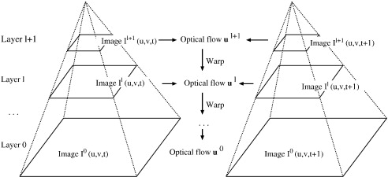
(1) Pipelined execution of independent pyramids of optical flow reduce latency
Dense optical flow uses 70 % of total computation time

Slide 41
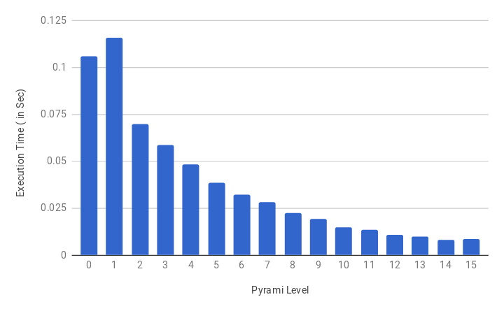
(1) Pipelined execution of independent pyramids of optical flow reduce latency
~0.5 sec to ~0.1 second

Slide 42
(2) Parallelize execution
0.1 sec to 17 ms
Impl. | CPU Runtime (Normal) | FPGA Impl. Approx.
Projection | 2.89 s | ~3 ms
Optical Flow | 16.21 s | 17 ms
View Synthesis | 4.5 s | ~4.5 ms
Notes:
Highly parallel FPGA architectures can make real-time stitching of 360 video possible
To conclude everything together

Slide 43
Reduce and reuse data to save power and improve latency.
Optimize Capture Power
Sensor ADC
Optimize Compute Power
Data Reuse
Data flow optimization
Latency
Pipelining
Parallelize
Notes:
Principles for End-to-End System Optimization

Slide 44
Summary
VR content generation is an important research problem
Our characterization highlight the bottlenecks in sensor, interface, and processing.
Closer integration of subsystems can help reduce and reuse data.
Proposed solutions make a case for accelerator on edge.

Slide 45
Extra slides
ODS capture generation

Slide 46
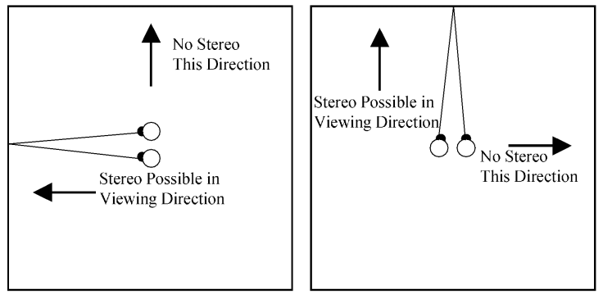
Background: Stereo Vision

Slide 47
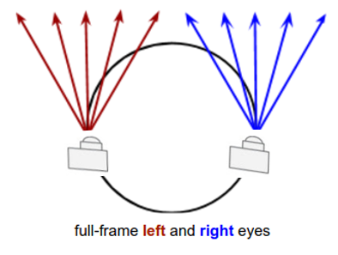
Background: Binocular Vision and Viewing Circle
Binocular Vision/Stereo Vision needs two views

Slide 48
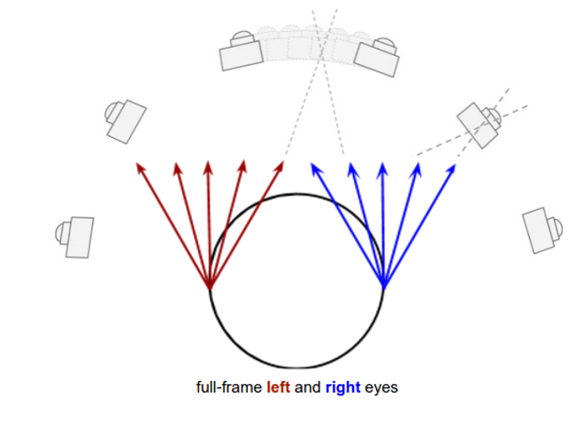
Background: How ODS works?
Notes:
Extrapolate the rays, if lucky you will find a camera view. Otherwise you can approximate the camera view.

Slide 49
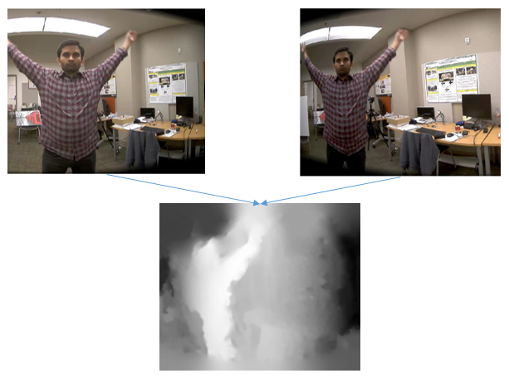
Background: How ODS works? Optical Flow
Based on depth of each pixel
Synthesize intermediate views

Slide 50
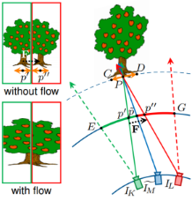
View Synthesis
MegaStereo, CVPR 2013

Slide 51
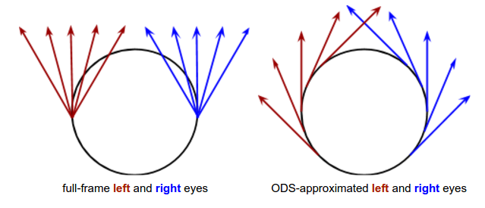
Background: How ODS works? View Synthesis
Instead of synthesizing all the viewpoints, we approximate the rays, thereby saving computations

Slide 52
That is how we generate ODS Panoramas
Left Eye
Right Eye
Notes:
capture entire 360 x 180, Mono – Portable, usable because of small size. ODS – Depth

Slide 53
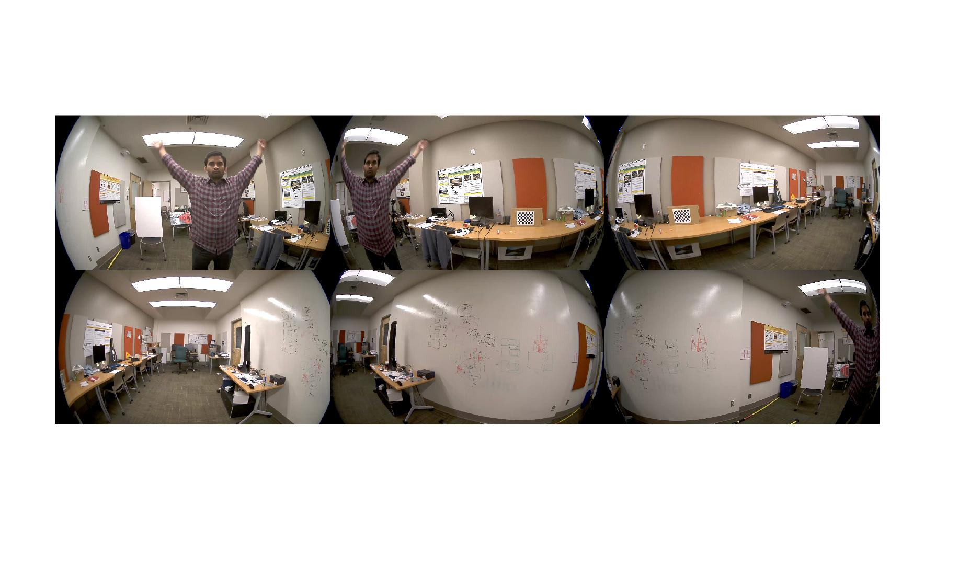
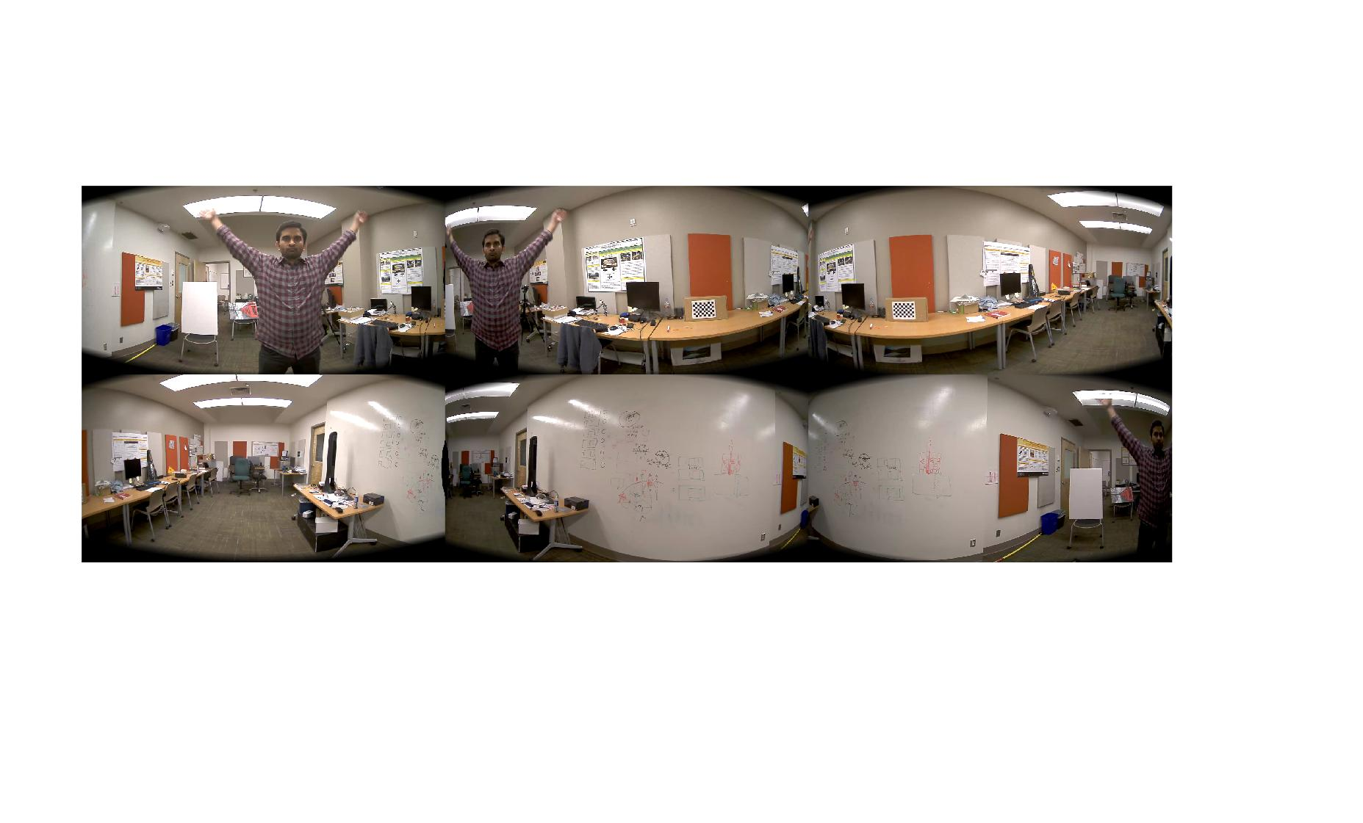
Step1– Equirectangular Projection
Multiple cameras streams

Slide 54
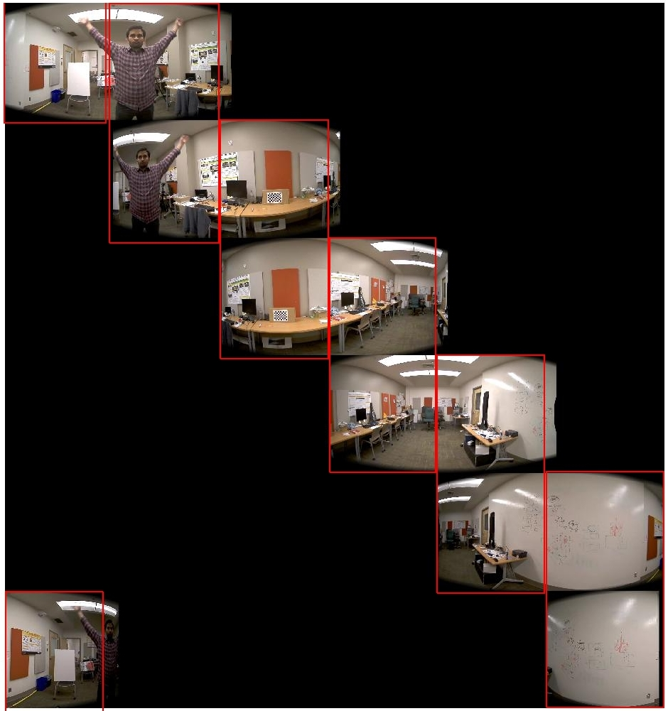
Step2– Overlapping regions b/w adjacent camera views

Slide 55


Step3– Optical Flow b/w adjacent Cameras

Slide 56




Step4– Optical Flow (With Temporal Regularization)

Slide 57
That is how we generate ODS Panoramas
Left Eye
Right Eye
Notes:
capture entire 360 x 180, Mono – Portable, usable because of small size. ODS – Depth

Slide 58
Previous Works
Google Jump. [Halide pipelines, CPU scheduling]
Facebook [multi-threading on CPU]
Muzamder[Halide, parallel GPU]
Our focus:
To find out inefficiencies in computation.
To characterize the bottlenecks and propose directions.

Slide 59
Camera Calibration
Intrinsic
Extrinsic
Rig calibration
Fisheye Circle
Hough transform of well-lit captures
Fisheye distortion

Slide 60


System Overview

